Slide 1
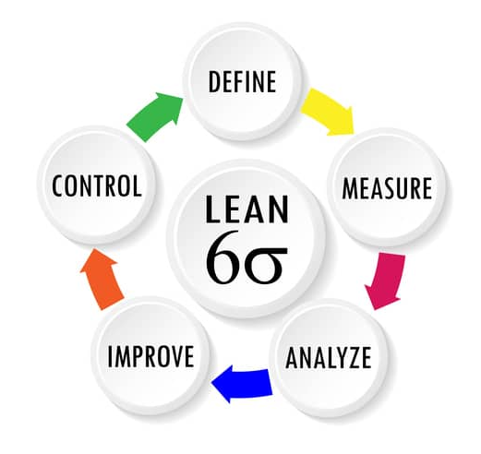
SIX SIGMA METHODOLOGY
IT Projects Management 1100-ZP0UEN Information technology laboratory (LI) Winter Semester 2024/2025

Slide 2
What is Six Sigma?
Six Sigma is a business methodology for quality improvement that measures how many defects there are in a current process and seeks to systematically eliminate them.
In 1984, a Motorola engineer named Bill Smith developed the Six Sigma management system to reduce the variations in Motorola's electronic manufacturing processes that were causing product defects.

Slide 3
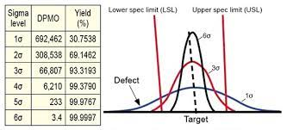

Slide 4
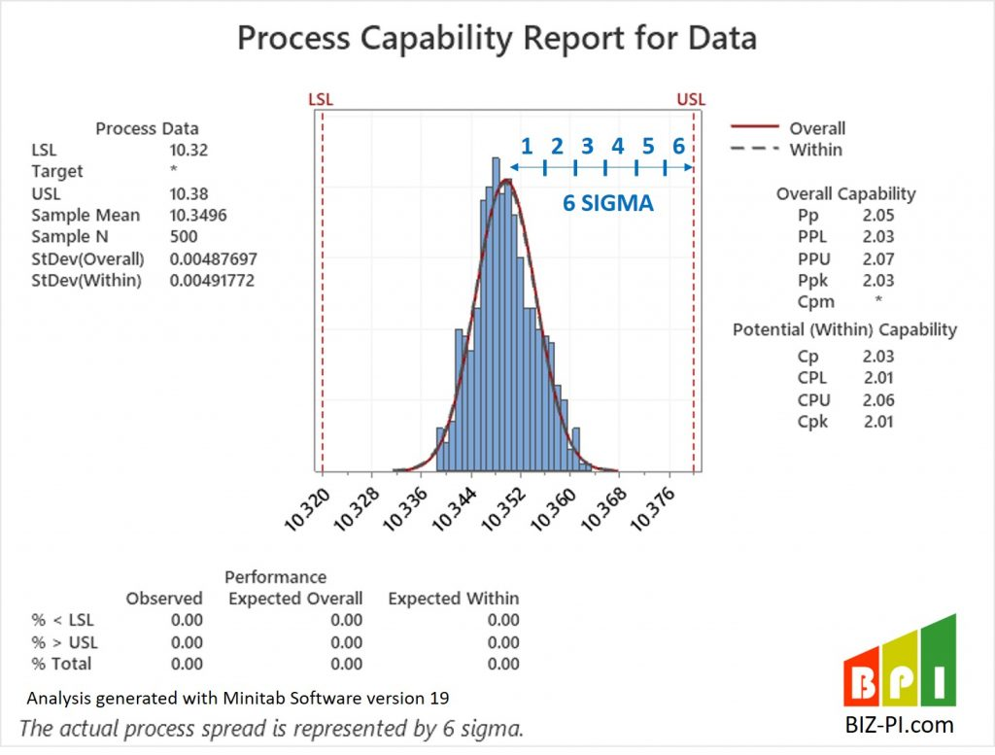

Slide 5
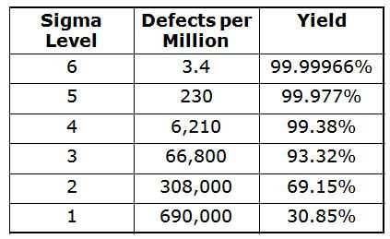

Slide 6
How does Six Sigma work?
In statistical analysis, the Greek letter sigma is used to denote a standard deviation from the mean.
In the 1920s, statistical process control pioneer Walter Shewhart proposed that in lean manufacturing, three sigma from the mean is the tipping point that indicates there are too many defects and process improvement is required.
This was the accepted norm for many years until Bill Smith proposed gathering and analyzing data at a more granular level and making six sigma the point at which a process has to be corrected.
Because it is almost impossible to achieve zero defects -- a concept known as infinity sigma -- six sigma allows for 3.4 defects per million opportunities for a defect to occur. In contrast, three sigma allows for 66,807 defects per million opportunities.
Once the necessary data has been gathered, a company that is implementing Six Sigma methodologies uses statistics to create a baseline sigma. The baseline illustrates how close -- or how far -- the company is from achieving six sigma and serves as a measuring stick for assessing future improvement.

Slide 7
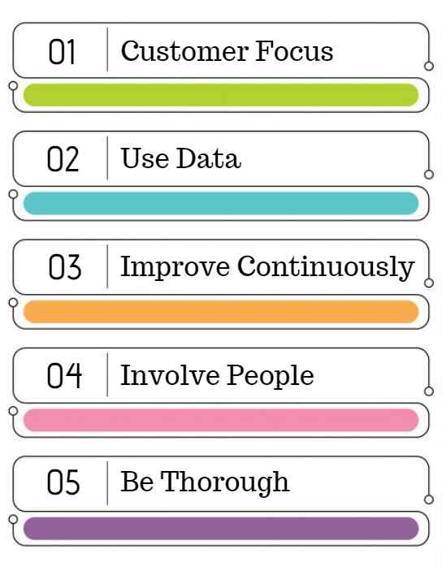
Principles of Six Sigma
There are 5 key principles of Six Sigma

Slide 8
Focus on Customer Requirements:
The initial phase in Six Sigma process is defining the “quality" from the point of customers. Every customer defines quality differently.
Use data to identify the variation in the process:
Variations in the process are of two types; Special cause variation and Natural variation. Special cause variation is caused by external factors.
To collect detailed data:
Define the goals for data collection clearly
Identification of the data.
Define the reason for the data collection
Define the expected insight
Define the data collection method
Eliminate the error in the data collection by doing Measurement System Analysis
Define the Data collection plan
Data collection in the Six Sigma process includes interviewing with people, taking observations, and asking questions.

Slide 9

Continually improving the process to eliminate the variation:
After identifying root causes, make changes to eliminate variation in the process. Thus, the defects in the process are removed. Additionally, search for ways to remove steps that do not add value to the customer.
Involve people from different levels of management and process:
Six Sigma is formed on the foundation of good teams. The good teams comprise of peoples who take responsibility for the Six Sigma processes. The people on the team need training in Six Sigma's methods. Forming a cross-functional team with peoples from different backgrounds will help identify variation.

Slide 10
Be flexible and thorough:
Six Sigma requires adaptability from various points of view. The business’s management system needs to acknowledge positive changes. People should be motivated to accept the changes in the system to eliminate the variation. To motivate the employee, the benefits of the six-sigma system should be made clear to all levels of employees. This will make the changes easily acceptable.

Slide 11
Six Sigma methodologies
DMAIC (define, measure, analyze, improve, control) is used to correct a process that already exists.
DMADV (define, measure, analyze, design, validate) is used to create a new process

Slide 12
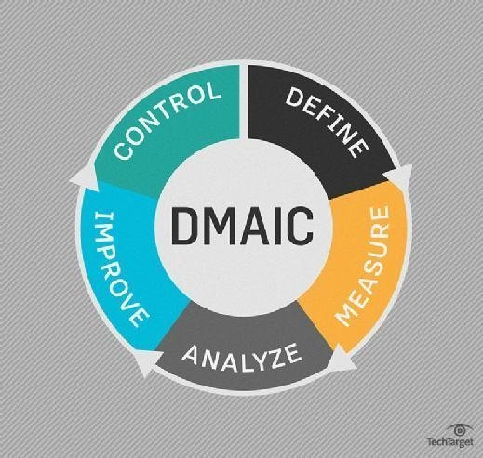

Slide 13
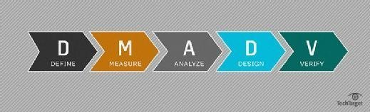

Slide 14
How to implement Six Sigma
Step 1: Motivate stakeholders by highlighting quality losses.
Step 2: Implement project management and obtain the necessary resources.
Step 3: Educate team members on the Six Sigma management method.
Step 4: Create a quality control chart and identify priorities.
Step 5: Assign ownership for all team members involved.
Step 6: Ensure measurement of the right metrics and indicators.
Step 7: Perform a root cause analysis to understand the defect.
Step 8: Govern the program to ensure proper implementation and continuous improvement.

